Slide 1

Computer Graphics and Game Development
GIMP 1
2016 Fall

Slide 2
What is GIMP?
GIMP is free version of PhotoShop. It is a free raster graphics editor used for:
1. image retouching and editing
2. free form drawing
3. resizing, cropping
4. Photo montaging
5. Much more

Slide 3
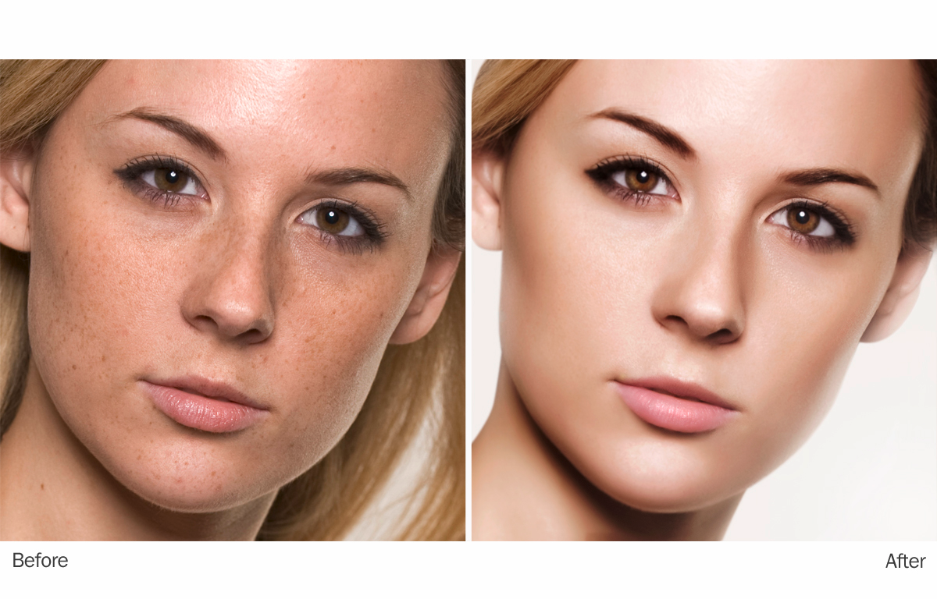
Retouching

Slide 4
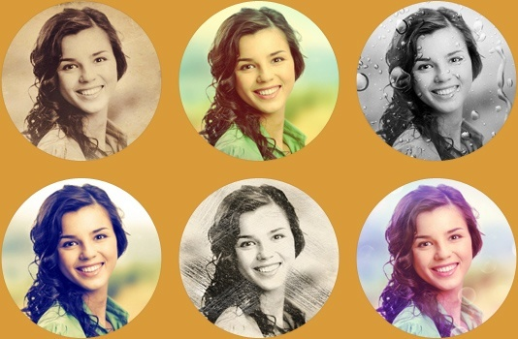
Editing

Slide 5
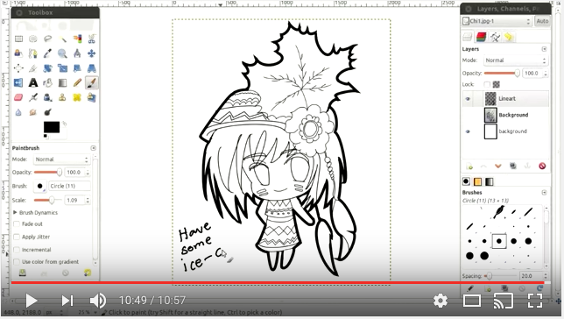
Drawing

Slide 6
Basics
Changing the Size (Dimensions) of an Image (Scale)
Changing the Size (Filesize) of a JPEG
Crop an Image
Rotate or Flip an Image
Download the sample image at
http://apod.nasa.gov/apod/astropix.html
Step-by-Step instruction at
https://www.gimp.org/tutorials/GIMP_Quickies/

Slide 7
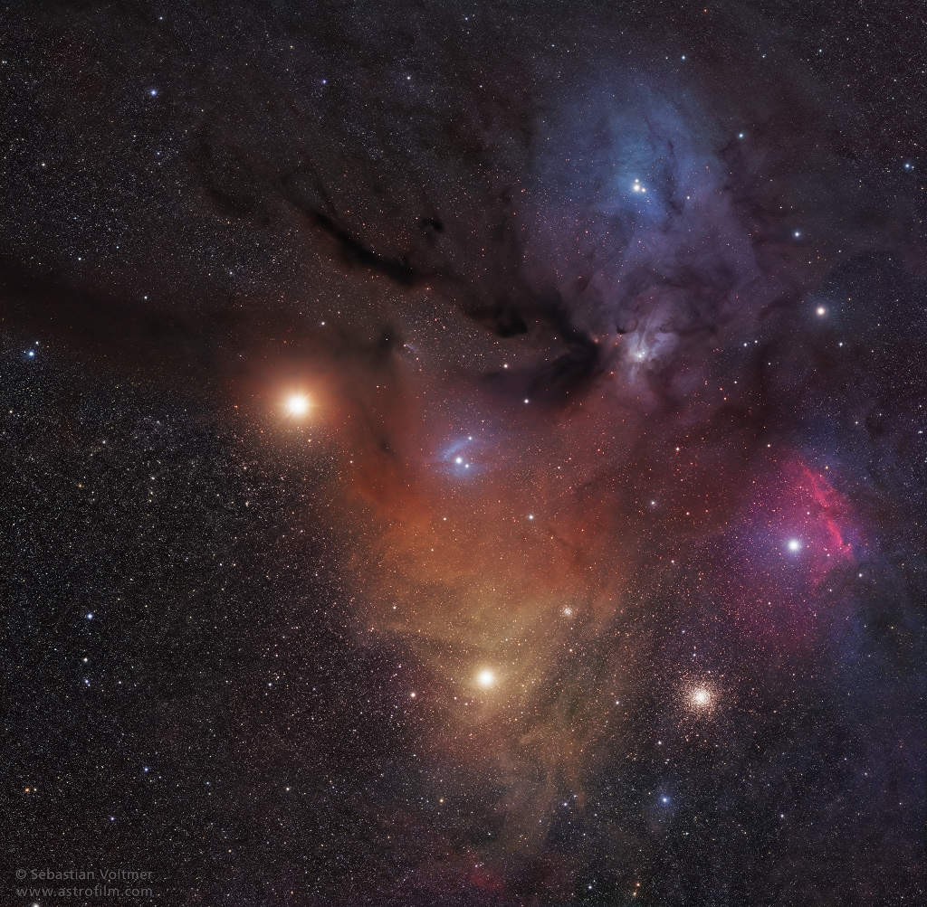
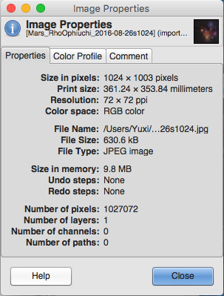
Image Properties
ppi: pixels per inch

Slide 8
Change the dimension of an image (Image → Scale Image → Export)
Used in email
Used on a web page

Slide 9
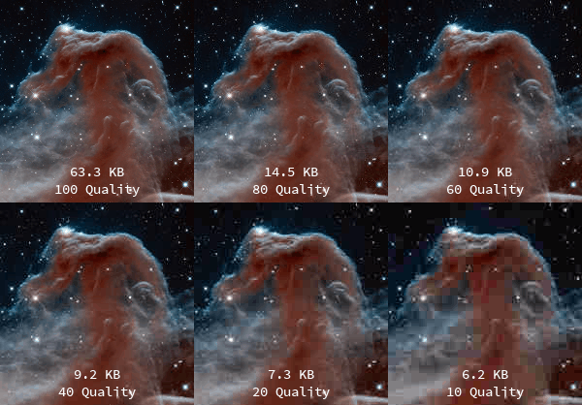
Change the file size of an image (File → Export) for easier sharing via email, iMessage etc.

Slide 10
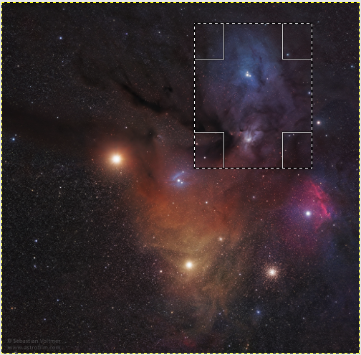
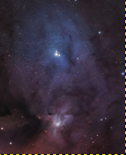
Crop an image (Crop tool, Selection → Crop to selection, Selection → Copy/Paste as new Image

Slide 11
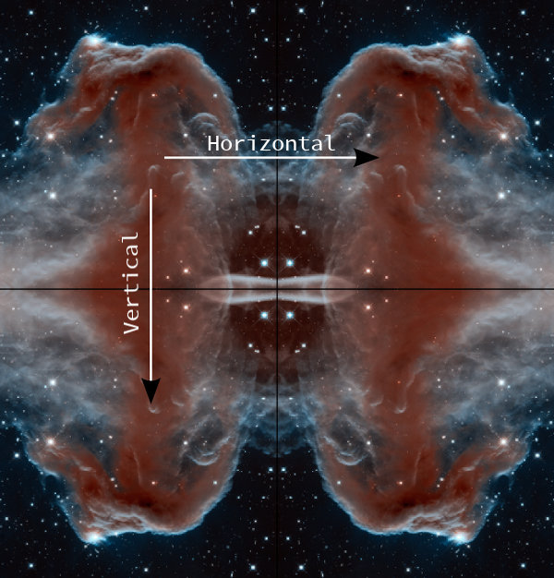
Flip an Image (Image → Transform → Flip)

Slide 12
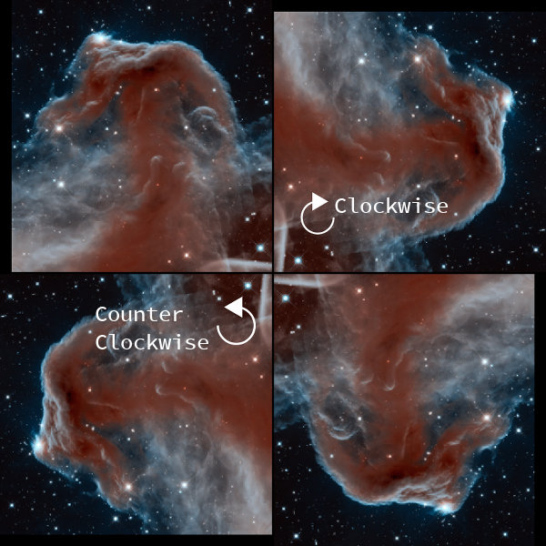
Rotate an Image (Image → Transform → Rotate)

Slide 13

Floating Logo
Step-by-Step instruction at
https://www.gimp.org/tutorials/Floating_Logo/

Slide 14
Homework
Finish/review examples in the class
Make a circle-shaped image following the tutorial at https://www.gimp.org/tutorials/CircleImage/
Make a floating logo image following the tutorial at https://www.gimp.org/tutorials/Floating_Logo/

